Slide 1



Java
Path finder
30 April 2025
Domenico Popolizio, Nicola Zarbo, Enrico Vento, Federico Valentino
1

Slide 2


What’s
JPF
2

Slide 3

Operates on Java bytecode
It handles instructions generated by a standard Java compiler. It can test an entire system or small portions of code, through usage of Java Annotations
Explores all possible Execution Paths
JPF identifies execution choices, or points in which the execution of the system under test could diverge
A VM Supporting Model Checking
A tool for Mission Critical Applications
In some scenarios, we cannot afford to learn about defects after deployment. As of now, there are defects that can be only identified through JPF.
3

Slide 4







Timeline
1999
2000
2003
2005
2008 and on
NEED
Model checking real java systems
SPIN FRONTEND
Java to Promela
NASA
JPF VM
NASA
EXTENSIBILITY
OPEN SOURCED
GOOGLE
SUMMER CODE
And Further development
4

Slide 5


Explicit State Model Checking
Symbolic Execution
State Matching
Key Features
Backtracking
Partial Order Reduction
Extensibility
5

Slide 6

Install &
Config
6

Slide 7


Linux
Windows
Fairly quick and easy process, the better alternative
We recommend using WSL
7

Slide 8

Download JDK
Make sure to download the correct version of the Java Development Kit. As of now, JDK 11 is the right version, but since it is subject to change, refer to the official JPF Github page
Download Git
Preliminary Steps
Verify that Git is installed on your machine before proceeding to the installation steps
Set up Environment Variables
Ensure that JAVA_HOME has been created as a new environment variable, and that Git has been added to the Path environment variable
8

Slide 9
1.
Clone the JPF GitHub Repository
Navigate to the desired folder, and then input the following command:
git clone https://github.com/javapathfinder/jpf-core.git
2.
Run the Gradle script
Navigate to the jpf-core subdirectory and run the gradlew script in a shell:
./gradlew
Installation Steps
3.
Set up the Environment Variables
You must now add a new environment variable, JPF_HOME, pointing to the jpf-core directory, and adding jpf as a system wide command:
Open .bashrc in nano to edit it
Add export JPF_HOME=/<path_to_jpf>/jpf
Add export PATH="$PATH:/<path_to_jpf>/jpf-core/bin"
Apply changes with source ~/.bashrc
9

Slide 10
4.
Create the site.properties file
Navigate to user/home and create the hidden directory .jpf
Within this directory, create a file names site.properties
Assuming the jpf-core folder is a subdirectory of user/home/jpf, edit the file to include the following content:
# JPF site configuration
jpf-core=${user.home}/jpf/jpf-core
extensions=${jpf-core}
Installation Steps
Notice - RAM Limitations
JPF is not a lightweight system. Some machines, especially embedded systems, may struggle to run it.
Ensure that your machine has more RAM than that required to host a Java Virtual Machine
10

Slide 11

Using
JPF
11

Slide 12

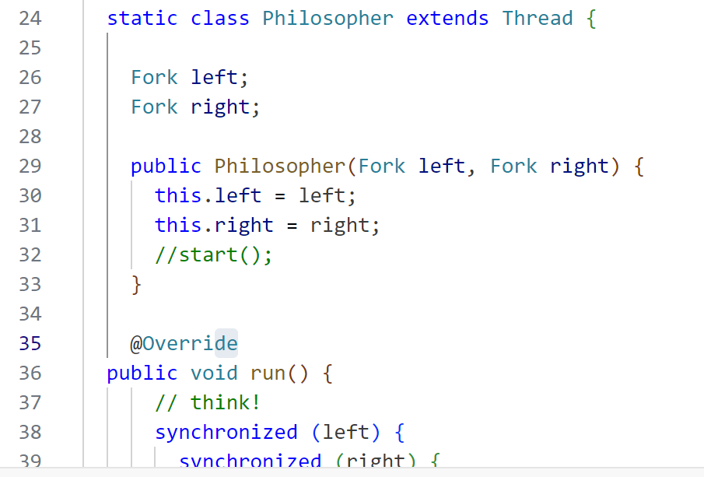
Program run by JPF
Being JPF itself a VM it runs java code.
This is crazy because it brings the power of model checking to a real programming language and real software!
12

Slide 13



Explored domains
Scheduling Sequences
Input
Variation
Environment
Changes
Control
Flow
Concurrent application are testable because we can control the scheduler.
Similar to systematic testing, it allows, through heuristics to test all the significant input spectrum.
JPF can simulate environment events, enabling model checking for application like IoT or Web
It automatically check all the branches of your code for running hidden parts of it.
13

Slide 14
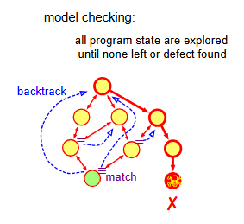
?
How JPF does the trick
JPF Performs model checking on the code execution, reaching all possible states.
14

Slide 15



{ }
System under testing
Model Java Interface
Java Path finder VM
Basic JPF
Structure
Java virtual Machine
Java Native Interface
Operating System
15

Slide 16


JPF Dependent program
The basic use is testing specific models and algorithm implemented in Java.
Program types
JPF Enabled programs
Programs that have only some parts that must be model checked
JPF is a very flexible tool and can be used with different types of program
JPF Unaware programs
Finally JPF can model check entire java programs that have been separately designed!
16

Slide 17
What
Testing specific models and algorithm implemented in Java, written for being tested with JPF.
Also, it takes less resources than checking real programs
Why
JPF
Dependent
JPF Allow you to have control over scheduling, finding race conditions
How
By being a VM, JPF can check any algorithm.
Moreover there are specific JPF Annotations and methods for implementing specific checks.
17

Slide 18
What
Normal java code, of any type.
Why
JPF
Unaware
To test in a deeper way than any other testing system.
How
JPF Being a VM can run any program, and model check them.
Notice that it will be slower than running on JVM, and that big program may lead to state explosion.
18

Slide 19
What
Problem where only a part of the code is going to be model checked
Why
JPF
Enabled
Model checking is resource expensive, testing entire programs may be not ideal.
You can test only part of a program.
How
Through annotation (e.g. @NonNull and many others) which JPF Recognizes and checks.
19

Slide 20
>_
Invoking JPF
JPF is invoked through the jpf command
~$
jpf <...>
Running
JPF
The alternative syntax, without storing jpf into the path is
~$
java -jar <jpf-core-dir>/build/RunJPF.jar <...>
JPF run every program similarly to how you run any java program
20

Slide 21
>_
Command line
The most basic way of running jpf
~$
jpf <main class>
Running
JPF
If the class is outside the configured project class path it can be specified
~$
jpf +classpath=<class-path> <main class>
Notice that other properties are specifiable, but this is not the correct place to do it
JPF run every program similarly to how you run any java program
21

Slide 22
>_
Example
~$
ls
HelloWorld.java HelloWorld.class
Running
JPF
~$
jpf +classpath=. HelloWorld
JPF run every program similarly to how you run any java program
22

Slide 23

>_
Create a .JPF File
~$
nano <name>.jpf
target = <main class>
classpath = <class-path>
.jpf
Files to run it
The classpath can be absolute or relative to the .jpf file location
Execution
Although you can run JPF like this, the correct way is different.
A . jpf file must be created
~$
jpf <JPF file>
23

Slide 24
>_
Example
Only the first time
~$
nano TestingHelloWorld.jpf
target = HelloWorld
classpath = ~/projects/difficulty/hard/
.jpf
Files to run it
Every time
~$
jpf TestingHelloWorld.jpf
Although you can run JPF like this, the correct way is different.
A . jpf file must be created
24

Slide 25


>
System Under Testing
This output come from the system under testing, and depends on what that systems prints out.
Reports
This is the core of JPF output, and practically essential to make the model checking significative.
Outputs
Logging
Won't go into details: it is possible to log with standard java loggers, the internal mechanism of JPF.
There are various level of details.
25

Slide 26
Code
Java Output
>
public class Rand {
public static void main (String[] args) {
Random random = new Random(42);
int a = random.nextInt(2);
System.out.println("a=" + a);
int b = random.nextInt(3);
System.out.println(" b=" + b);
int c = a/(b+a -2);
System.out.println(" c=" + c);
}
}
$ java Rand.java
a = 1
b = 0
c = -1
S.U.T.
Output
Java Output
$ java Rand.java
a = 0
b = 1
c = 0
This output come from the system under testing, and depends on what that systems prints out.
Notice that it print everything even when backtracking!
$ java Rand.java
....
26

Slide 27
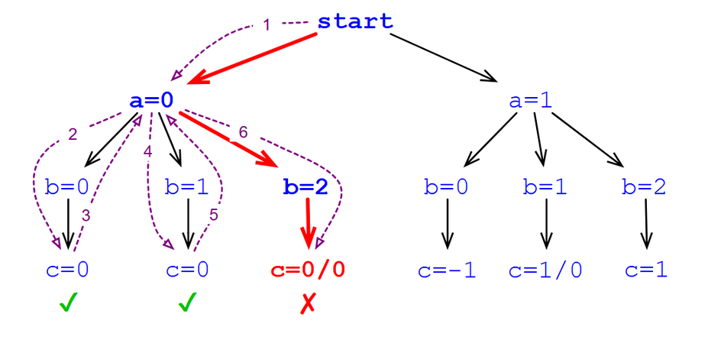
Code
JPF “Tree” Output
public class Rand {
public static void main (String[] args) {
Random random = new Random(42);
int a = random.nextInt(2);
System.out.println("a=" + a);
int b = random.nextInt(3);
System.out.println(" b=" + b);
int c = a/(b+a -2);
System.out.println(" c=" + c);
}
}
$ jpf Rand.jpf
a=0
b=0
c=0
b=1
c=0
b=2
Error
>
S.U.T.
Output
Java Output
This output come from the system under testing, and depends on what that systems prints out.
Notice that it print everything even when backtracking!
27

Slide 28
Code
JPF “Path” Output
public class Rand {
public static void main (String[] args) {
Random random = new Random(42);
int a = random.nextInt(2);
System.out.println("a=" + a);
int b = random.nextInt(3);
System.out.println(" b=" + b);
int c = a/(b+a -2);
System.out.println(" c=" + c);
}
}
$ jpf Rand.jpf
a=0
b=2
Error
>
S.U.T.
Output
Java Output
The path output stores the output and print only the output of the path that create the error!
This output come from the system under testing, and depends on what that systems prints out.
Notice that it print everything even when backtracking!
28

Slide 29
Output phases
Example report
Start (versioning, SUT), Transition (Statistics),
Property Violation (error, trace)
Start
JavaPathFinder core system v8.0 ....
=============== system under test
HelloWorld.main()
=================== search started: 30/02/2025
Hello World!
=================== statistics
elapsed time: 00:00:00
states: new=1, visited=1, backtracked=0, end=0
search: maxDepth=3, constraints=0
choice generators, heap, instructions,
max memory, loaded code
Now I am going to perform 3/0 =
==================== error 1
gov.nasa.jpf.vm.NoUncaughtExceptionProperty
java.lang.ArithmeticException: division by zero
at UncaughtException.main (UncaughtEception.java:3)
===================trace #1
-------------------------- transition #0 thread: 0
HelloWorld.java:4
System.out.println(“Hello World!”);
HelloWorld.java:5
if(true) {
-------------------------- transition #1 thread: 0
HelloWorld.java:5
if(true) {
HelloWorld.java:6
System.out.print(3/0);
Configurations Date-Time Versioning
Platform SUT Class User
Transition
Report
Output
Statistics
Probe
Statistics Probe interval
Property Violation
Error Snapshot
Output Statistics
Trace (config, code, location, method, source steps)
This is the core of JPF output, and practically essential to make the model checking significative.
Constraints
Constraint Snapshot
Statistics Output Trace
Supports: Text, XML, API Calls
Target: IDE
Finished
Statistics
29

Slide 30
The Test Class
JPF already uses JUnit as internal testing infrastructure. We can exploit this to write our own custom test classes
import gov.nasa.jpf.util.test.JPFTestSuite;
import org.junit.Test;
public class MyTest extends TestJPF {
@Test
public void testSomeFunction() {
if (verifyNoPropertyViolation(jpfOptions))
{
someFuntction();
}
}
JPF and JUnit Tests
We can run JPF verification directly inside a standard JUnit test class
The function within the class will be tested by JPF
30

Slide 31
We can run these test classes simply by command line
bin/test <test-class> [<test-method>]
Which in turn call the executable java -jar tools/RunTest.jar
JPF and JUnit Tests
We can also specify temporary JPF properties, for example, using a specific listener
bin/test+test.listener=.listener.ExecTracker gov.nasa.jpf.test.mc.basic.AttrsTest
31

Slide 32
>
public class MyJPFLauncher {
...
public static void main(String[] args){
..
try {
Config conf = JPF.createConfig(args);
conf.setProperty("my.property", "whatever");
MyListener myListener = ...
JPF jpf = new JPF(conf);
jpf.addListener(myListener);
jpf.run();
if (jpf.foundErrors()){
}
} catch (JPFConfigException cx){
} catch (JPFException jx){
}
...
jpf.run()
Launch From Within a Program
JPF can be launched directly inside a JAVA program, and it’s output can be used in the program flow itself
32

Slide 33
Annotations
@JPFConfig(...) allow to add per-method configurations
@FilteredField allow to specify variable as non relevant for states
@Nonnull @NonShared @Immutable @Requires ....
Verify API
Enable to verify explicit behavior
Data Choice Generators
boolean cond = Verify.getBoolean()
int d = Verify.getInt(0, 100); ....
Search Pruning
Verify.ignoreIf(condition );
State Annotation
Verify.interesting(condition)
if(condition) { Verify.setAnnotation(“label”); }
Atomicity Control
Verify.beingAtomic() ---- 1 transition only -----> Verify.endAtomic();
Coding JPF
Dependent
33

Slide 34
What are JPF Properties
Each property is a key - value statement, presented int he following format:
key = value
For example, consider the file presented in slide 23, reported here:
~$
nano <name>.jpf
JPF Properties
target = <main class>
classpath = <class-path>
These are both JPF properties
JPF is not a monolithic solution, and should be configured to better fit our needs. Its properties are the main configuration mechanism
34

Slide 35
Site Properties
Comprised of properties in the form of <name> = <directory>.
A peculiar key is extensions, which can have as values a comma separated series of jpf-core modules and user made extensions.
It is mandatory to have ${jpf-core} listed in the extension key
Project Properties
Each JPF module, either core or extension, contains a jpf.properties file. The project property file defines the JPF specific paths that need to be set for the module to work properly. The relevant keys are:
native_classpath
classpath
test_classpath
sourcepath
Property Types
There are three different property files, each containing properties of the corresponding type. These files are referenced into a single dictionary object, the Config file (jpf-core/gov/nasa/jpf)
Application Properties
IIdentify the path of the system to be tested and specific properties on how to run the test
35

Slide 36
Location
User Defined
Uses
Identification of the SUT path
Personalizing testing options
Mandatory Properties
Application Properties
target = MyClass
classpath = <MyClass_path>
Other Properties
For examples, randomizing the order with which JPF chooses which branch to take
First Level of properties. Used to identify the system under test and to define how to run the test itself
cg.enumerate_random = true
cg.randomize_choices = VAR_SEED
36

Slide 37
Uses
Overriding properties in the application properties file
Convenient for quickly switching between useful property values
Application Properties
Syntax
cg.enumerate_random += true
Application properties can also be set by command line directly as properties of the jpf executable
37

Slide 38
Note
To gain access to JPF application properties that regard randomization, JPF requires access to the java.utils.Random library.
However, this seems to be a problem if using the version of JPF currently featured on the official GitHub page.
Application Properties
Solution
Go to the jpf-core/bin directory, and open the jpf script with nano. Paste this command at the end of the script
java \
--add-exports java.base/jdk.internal.misc=ALL-UNNAMED \
--add-opens java.base/jdk.internal.misc=ALL-UNNAMED \
-jar $JPF_HOME/build/RunJPF.jar "$@"
38

Slide 39
Location
jpf-core root directory
Uses
Configuration of a project run by a specific jpf version
Building a specific jpf version
Properties
Project Properties
jpf-core.native_classpath = [jpf path]
jpf-core.classpath = [bytecode to be model checked]
jpf-core.sourcepath = [sources to be model checked]
Third level of properties.
Used to configure but also build any project
Others
Other default setting for lower levels
39

Slide 40
Location
System.out.println(System.getProperty(“user.home”));
User home/.jpf/site.properties
Uses
Configuration valid for the user executing jpf in the os
Extensions
Properties
Site
Properties
jpf-core = [path to jpf-core]
jpf-extension-name = [path to another extension]
...
extensions = ${jpf-core}, ${jpf-extension-name}, ...
Fourth level of properties,
basically at O.S. Level
Others
Other default setting for lower levels
40

Slide 41


JPF
Exposed
41

Slide 42




Off-the-shell extensions
There are lot of extensions that fits wide range of needs
Unlocking Full Power
JPF Under the hood
Checking what's under the hood enable us to unlock the full potential
JPF is Open Souirce and highly extensible.
To extend it we need to have a look under the hood.
(Custom) Properties verification
JPF become not only for java errors!
We might check specific (custom?) properties!
42

Slide 43
jpf-core
Standard jpf
jpf-probabilistic
Jpf that consider the markov process underneath randomized algorithms.
jpf-symbc
Some extensions
Jpf for symbolic execution
jpf-aprop
Jpf with annotation based program properties
jpf-nhandler
Virtually infinite, here there are a few that might be interesting, even if they are out of the scope of understanding jpf itself.
Support running part of the code on the native JVM
BenchExec
Execute benchmark and resource management
43

Slide 44

The Virtual Machine
Holds classes and methods responsible for generating the state representations, which can be:
Checked for Equality
Queried
Stored
Restored
Understanding JPF Design
The Search Component
Decides which state to visit next, based on different properties to be checked and/or heuristics
JPF is designed with two principal components in mind
44

Slide 45

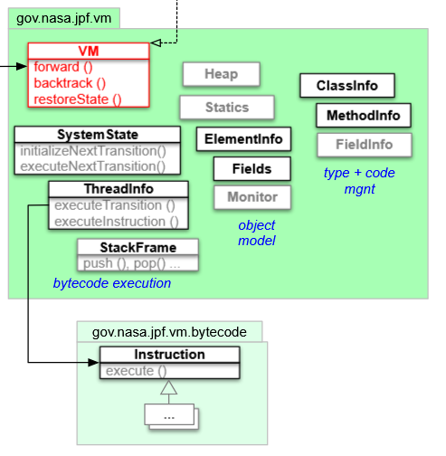
The VM Package
Functionalities
ClassInfo encapsulates and manages classes under test
Fields objects store into integer arrays all of the object data
SystemState and ThreadInfo handle the bytecode execution
forward(), backward() and restoreState() are methods invoked by the Search Component to either, repectively, progress to the next state, restore the state on top of the backtrack stack, or restore an arbitrary state of choice
45

Slide 46
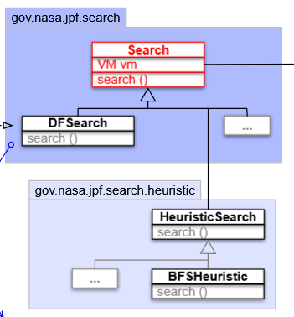
The Search Package
Functionalities
search() is the VM driver, selecting either forward(), backtrack() or restoreState()
DFSearch is the default depth first search streategy for the state space
HeuristicSearch and BFSHeuristicSearch configurable heuristics to drive the search towards state that show certain desired characteristics
This component can be extended with new search strategies and heuristics
46

Slide 47

State
Choice
Generator
Memory status.
Path that lead to it.
Program faces non-determinism problems.
Choice Generators Handle them.
47

Slide 48
Non-Determinism
Scheduling choices
Thread and shared objects
Data choices
Testing different variable values
Control choices
Checking multiple branches of conditions
Choice
Generator
?
Program faces non-determinism problems.
Choice Generators Handle them.
48

Slide 49



Solutions
Decouple the situation.
Different cases of non-determinism solved by different mechanisms.
Pre-Configure solution for basic cases
Scheduling, Boolean, naive control choices...
Non basic cases
Domain specific cases
Parametrization
External interface working at runtime (JPF Properties)
Choice
Generator
?
Program faces non-determinism problems.
Choice Generators Handle them.
49

Slide 50
Possible Choices
Driven by non-det.
Are possible new states based no how the non determinism is solved.
Choice
Generator
ChoiceGenerator
Program faces non-determinism problems.
Choice Generators Handle them.
Generates possible choices.
This is an extensible component (through heuristics).
50

Slide 51
JPF Unaware
Managed automatically by JPF
JPF Dependant
We can detail choice generation.
Basic types
E.g. Use the JPF Verify API Basic Types
Choice
Generator
boolean managed = Verify.getBoolean();
ChoiceGenerator
Generates possible choices.
Threshold values
E.g. Use the JPF Verify API Parametrization
Program faces non-determinism problems.
Choice Generators Handle them.
double speed = Verify.getDouble(“myheur”);
myheur.class = gov.nasa.jpf.jvm.choice.DoubleThresholdGenerator
myheur.threshold = 13500
myheur.delta = 500
51

Slide 52


Choice
Driven by non-det.
Starts transition to new state.
Choice
Generator
Transition
Moving from one state to another.
Program faces non-determinism problems.
Choice Generators Handle them.
52

Slide 53

Internally
Each state store its own choice generator.
System state set with a new choice generator when find non determinism.
Execute the code from the new state.
When finishing all the lower level choices, the systems rollback and try a different choice.
Choice
Generator
. . .
Objects
SystemState
initNextTransition()
setNextChoiceGenerator()
ChoiceGenerator
hasMoreChoices()
advace()
Program faces non-determinism problems.
Choice Generators Handle them.
ThreadInfo
ExecuteNextTransition()
ExecuteInstruction()
Instruction
execute()
53

Slide 54

POR optimization
Partial Order Reduction
scheduling relevant/nondeterministic instruction
JPF implements on the fly partial order reduction to achieve a reduction of 70% or more of state spaces
Sequence of instructions within a single thread that are not judged as scheduling relevant or nondeterministic are treated as a single transition
Partial Order Reduction can be enabled by setting vm.por = true in the application property file
54

Slide 55
Deciding scheduling relevance
An instruction is said to be scheduling relevant if it involves access to shared resources or thread synchronization. These can be instructions like get or set for shared resources, or monitorEnter/Exit for direct synchronization, or certain thread calls, like wait(), sleep(), start()
Partial Order Reduction
Deciding non determinism
An instruction is said to be nondeterministic if it involves unpredictable behaviors, such as reading a value from input, or generating a random number
JPF implements on the fly partial order reduction to achieve a reduction of 70% or more of state spaces
55

Slide 56
Limitations of Partial Order Reduction
JPF cannot handle diamond cases with partial order reduction, that is, when two thread join on a single state, as it doesn’t perform lookahead analysis
Partial Order Reduction
JPF implements on the fly partial order reduction to achieve a reduction of 70% or more of state spaces
56

Slide 57

Association through API
Program elements can be associated to attributes with the APIs given by:
gov.nasa.jpf.v.Fields for instance and static fields
gov.nasa.jpf.vm.StackFrame for stack slots (local operands and variables)
Attributes
Propagation
Each time a program element gets updated, JPF propagates the change to the corresponding attribute, to keet everything in sync
JPF extends the JVM with a storage mechanism that links variables, fields and even entire objects to configurable meta-data objects, called attributes
Backtracking Behavior
When backtracking, JPF only restores the attribute references, but not the values
57

Slide 58
Usage
Attributes can be used to assign symbolic values to certain variables or objects, enabling symbolic and concolyc execution.
Attributes
Limitations
Attribute generation and upkeep leads to a not indifferent slowdown in execution
Moreover, it is not possible to assign more than one attribute type to a single field or slot
JPF extends the JVM with a storage mechanism that links variables, fields and even entire objects to configurable meta-data objects, called attributes
58

Slide 59



Diagram
External observers.
No need to rebuild JPF every time.
{ }
System under testing
JPF
VMListener
Virtual Machine
Listeners
Listeners
Search system
SearchListener
. . .
Observer of the running VM and JPF that enable to check the execution.
Main extension point of jpf.
Usable through JPF Properties
Using listeners
Inside the property
listener = [list of listener classes]
59

Slide 60

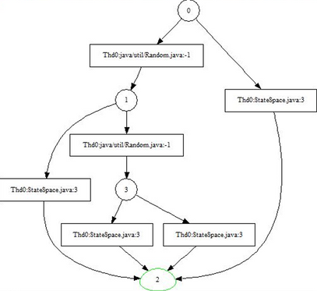


gov.nasa.jpf.listener.StateSpaceDot
Draw the state space explored by JPF.
Uses .dot (dotty format)
can be opened with GraphViz
gov.nasa.jpf.listener.BudgetChecker
Some
Listeners
Control resource contraints are not violated.
budeget.max_time = ...
budeget.max_heap = ...
budeget.max_instn = ...
budeget.max_state = ...
Standard listeners exists
gov.nasa.jpf.listener.EndlessLoopDetector
Control heuristically that there are no infinite loops
idle.max_backjumps = ...
60

Slide 61
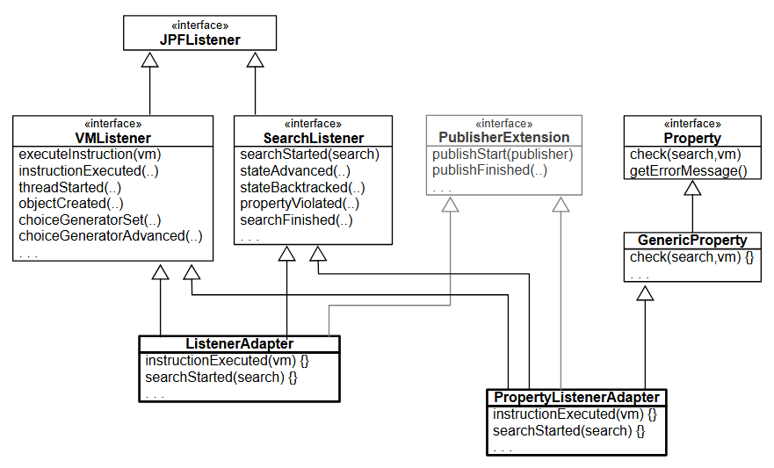
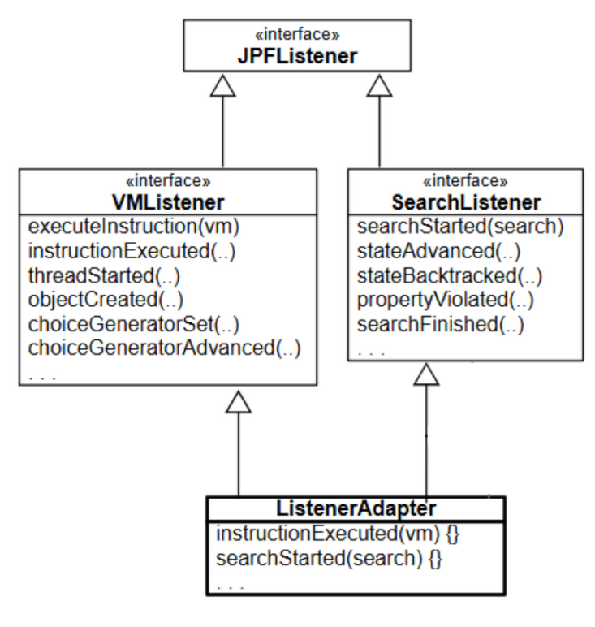
Extending
Listeners
It is complex but feasible extending JPF Classes.
You have to implement the interface or the abstract adapter for what you want to listen (JPF VM or JPF Search)
Every listener can also have properties.
Properties are set run time
Every listener can check property violations.
61

Slide 62
Extending
Search
As we’ve already mentioned, we can extend the Search package with our own search strategies.
This is done by extending the Search abstract class as we would normally do in java
62

Slide 63
Constructor
Our class should have a public constructor, receiving the JPF Config file and the JPF Virtual Machine reference as input
Extending
Search
Going Forwards and Backwards
As we have already seen, we can use the methods forward() and backtrack() to either explore a new state or go back to the previously explored one. We can also leverage these methods of the Search class to understand where we are exactly in our search:
isNewState tells us is we’ve never seen the current state
isEndState tells us whether the current state is final
isIgnoredState tests whether the current state should be ignored for search purposes
Let’s now see what characteristics our custom class should have, and which existing methods and attributes we can leverage from the Search class
63

Slide 64
Interaction with Other Components
Listeners could end a search by manipulating the Search class attribute done: this should be considered accordingly in our code
Other components can request a backtrack through the requestBacktrack() method of Search class. We can check whether this has happened with the Search method checkAndResetBacktrackRequest()
Extending
Search
Adapting to Search Related Properties
Let’s now see what characteristics our custom class should have, and which existing methods and attributes we can leverage from the Search class
Let’s see how to take into account some of these properties:
search.depth_limit → use getDepthLimit()
search.min_free → use checkStateSpaceLimit()
search.multiple_errors → use hasPropertyTermination(), in combination with the done attribute
64

Slide 65
Notifications
Extending
Search
A proper search should notify different listeners of certain events. The interface SearchListener offers us a wide array of notifications:
notifyStateAdvanced()
notifystateBacktracked()
notifyStateProcessed()
notifySearchStarted()
notifySearchFinished()
notifyPropertyViolated()
notifySearchConstraintHit(String)
Let’s now see what characteristics our custom class should have, and which existing methods and attributes we can leverage from the Search class
65

Slide 66


Bytecode Factory
Enable to implement new and existing bytecodes
Extending the VM
Model Java Interface
Interface SUT with Native JVM
The VM implemented by JPF is itself expandable.
This is out of scope of our explanation but it is interesting!
66

Slide 67
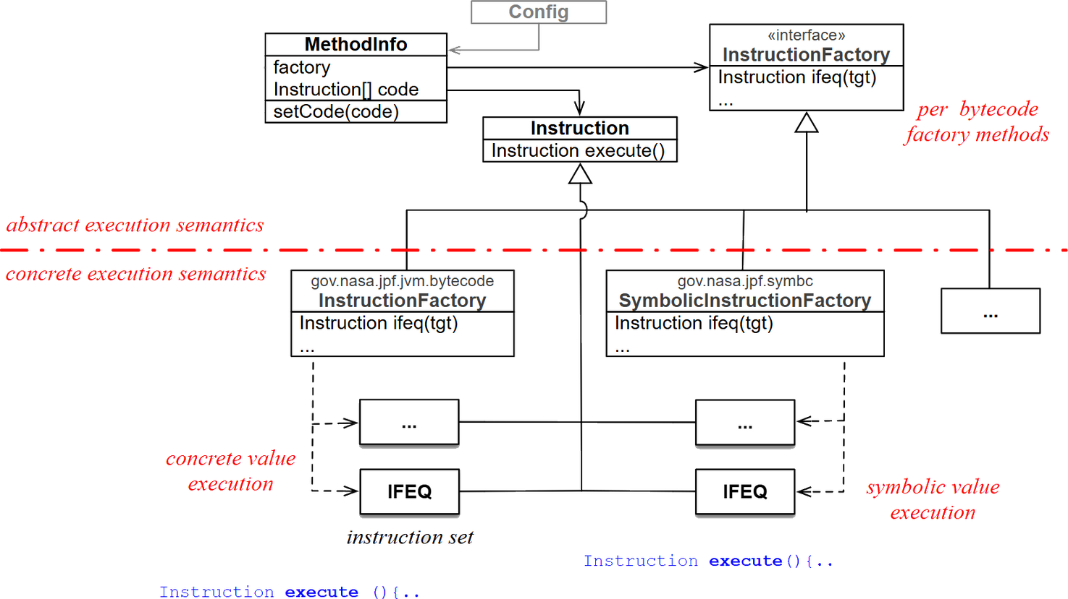
Bytecode
Factory
We can specify new instructions, and give a concrete or symbolic execution method.
67

Slide 68
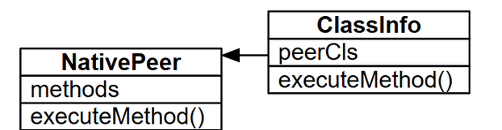
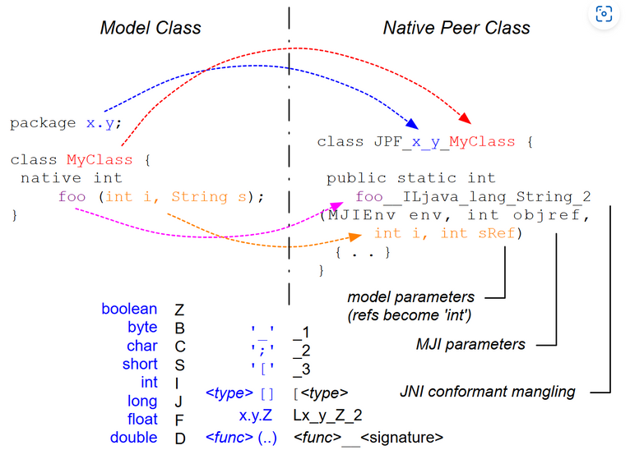
Java Path finder VM
Model Java
Interface
Native JVM
Interface SUT with Native JVM.
A Native Peer is associated to a model class to execute native method (when loading the model).
For system specific needs
Enabling state reduction (state are not tracked)
Still permitting some checks (ie. threads management)
68

Slide 69

Our
bibliography
69

Slide 70

JPF Documentation
https://github.com/javapathfinder/jpf-core/wiki/
As of 04/2025, by JavaPathFinder
Java PathFinder: a tool to detect bugs in Java code
F. van Breugel • 2020 • York University
Model checking programs
Bibliography
Visser, Willem & Havelund, Klaus & Brat, Guillaume & Park, Seungjoon. (2000). Model Checking Programs. Automated Software Engineering. 10. 3-11. 10.1109/ASE.2000.873645.
Java PathFinder
A. Mannem, D. White, M. Yousaf • University of Texas at Arlington
70

Slide 71
Thank
You
30 April 2025
Domenico Popolizio, Nicola Zarbo, Enrico Vento, Federico Valentino
71

Slide 72

Time For The Demos
72

